Slide 1
HR Analytics - Data Pitch
ANGADH, GIULIO, NISCHAY, DARREN

Slide 2
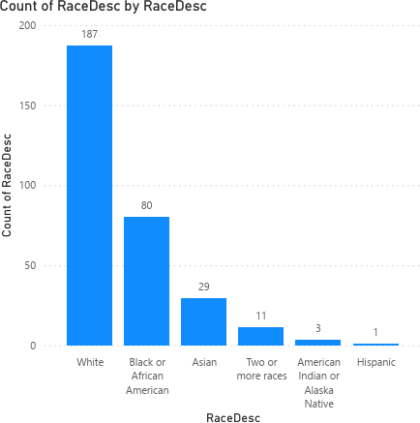
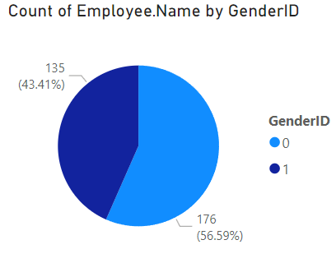
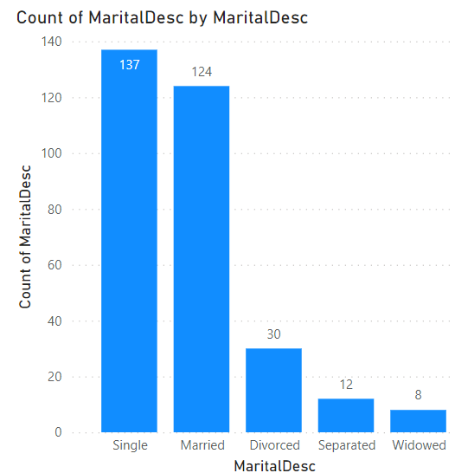
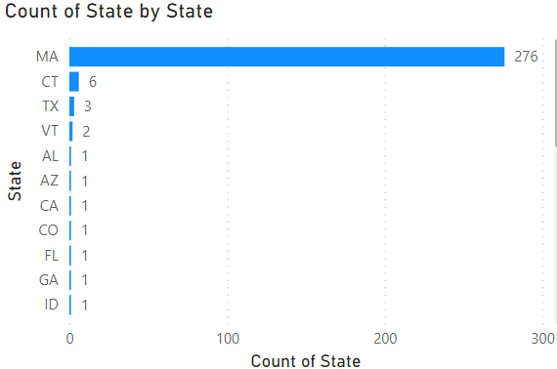
Can we say that the company is diverse? How? Why?

Slide 3
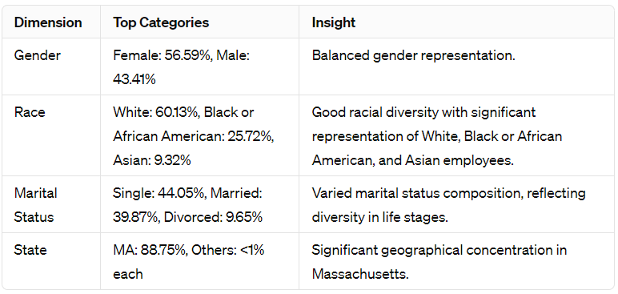
Racial Diversity:
The presence of multiple races and ethnicities among the workforce indicates a level of racial diversity But its Highly white dominant (60%) followed by Black or African American (25%). Other races are not well represented, so opportunities to further enhance diversity, particularly by increasing representation of underrepresented groups.
State Diversity:
The state diversity indicates a significant geographical concentration in Massachusetts, due to the company's location and its primary operational base. While this concentration might facilitate operations and collaboration, expanding the geographical diversity of the workforce could introduce new perspectives and potential benefits associated with a more geographically dispersed team.
Marital Status Diversity:
Reflects a varied marital status composition, indicating diversity in life stages and experiences among employees. Such diversity can bring a wide range of perspectives and insights to the company, enriching the workplace culture.
Gender Diversity:
Relatively balanced gender distribution within the company, indicating a commendable level of gender diversity.

Slide 4
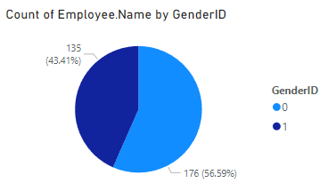
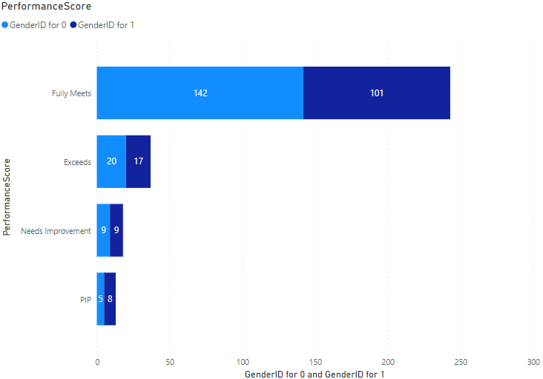
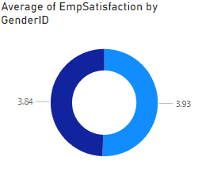
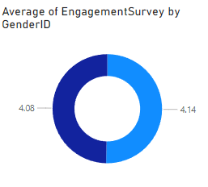
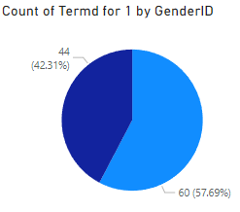
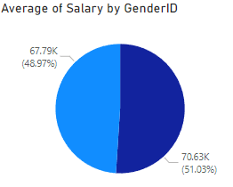
To what extent gender equality is achieved in the organization?

Slide 5
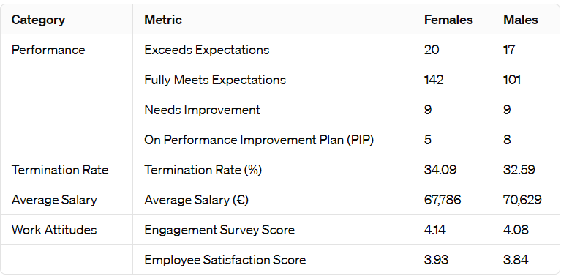
Performance by Gender :
Both genders perform comparably well, with a slightly higher number of females meeting or exceeding performance expectations.
Termination Rate by Gender :
The termination rates are relatively close, suggesting no significant gender disparity in turnover
Average Salary by Gender :
There is a noticeable salary gap, with males earning more on average than females. This difference highlights an area for improvement in terms of salary equality.
Work Attitudes :
Females slightly lead in engagement and satisfaction scores, indicating potentially more positive work attitudes among female employees.

